Slide 1



Spend less time TUNING and more time CHILLING
Some tips and tricks for achieving good performance on any
Deep Learning Task
Atif Hassan

Slide 2
Good Coding Practices
Writing code the correct way helps reduce experimentation time and allows you to directly convert your methodology into a library

Slide 3
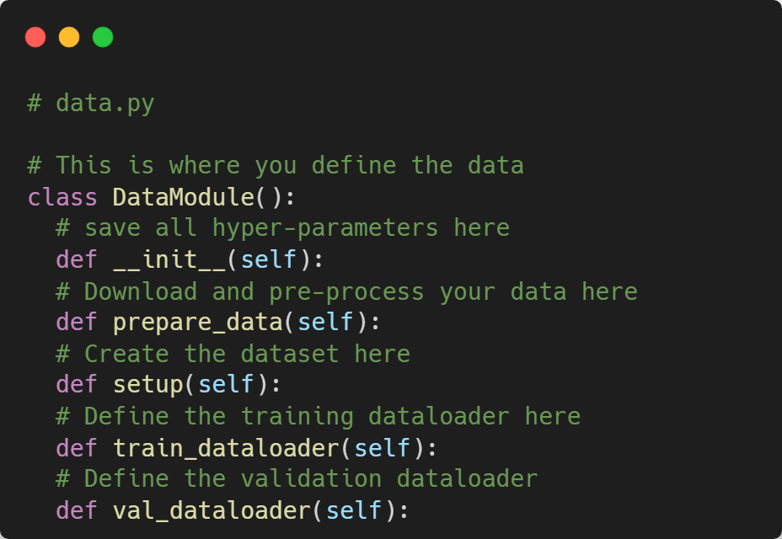
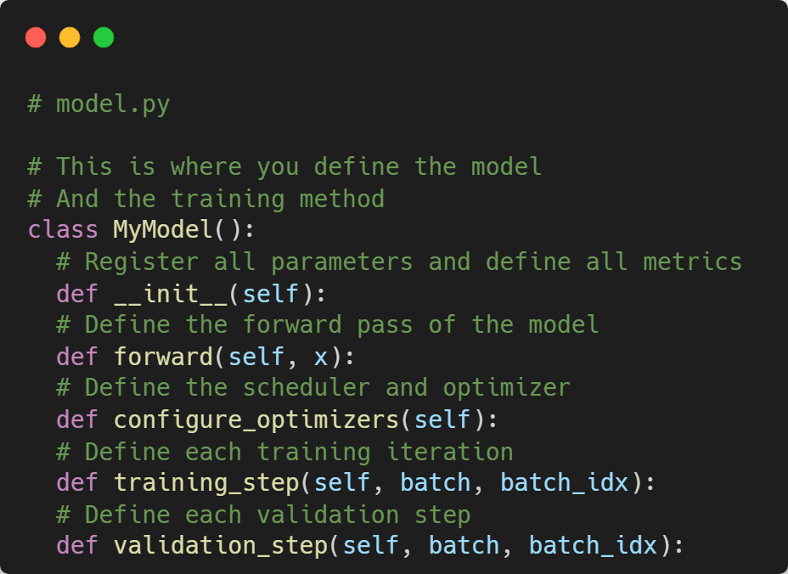
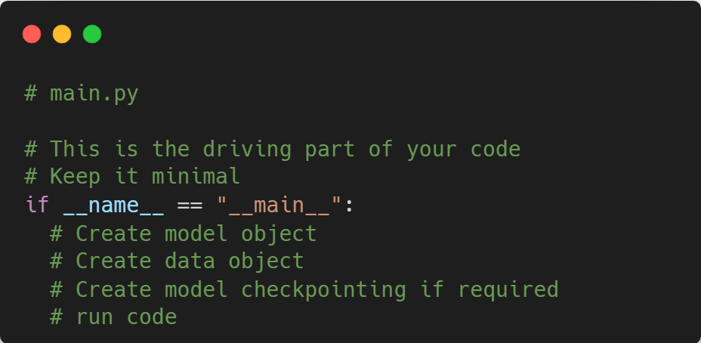
OOP is the way

Slide 4
Data Augmentation
A good Data Augmentation Policy often produces large improvements in generalization

Slide 5
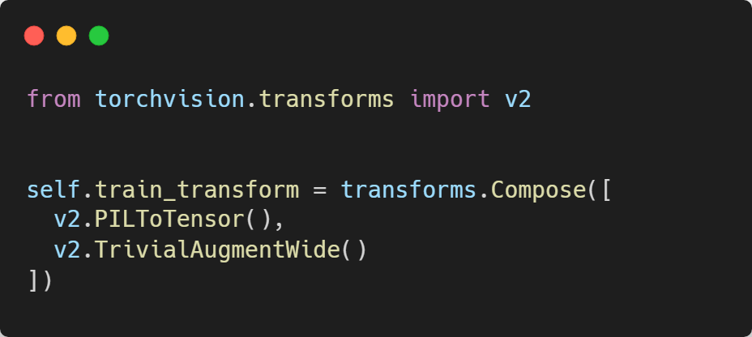
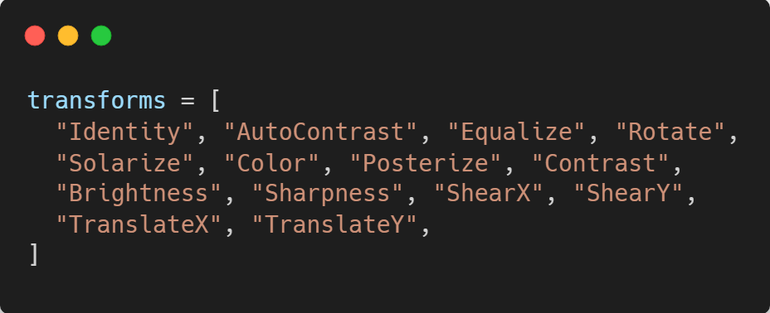
TrivialAugmentWide
Successor to the RandAugment method.
Q. Why?
A. Perturbing images introduces regularization.
Müller, Samuel G., and Frank Hutter. "Trivialaugment: Tuning-free yet state-of-the-art data augmentation." In Proceedings of the IEEE/CVF international conference on computer vision, pp. 774-782. 2021.

Slide 6
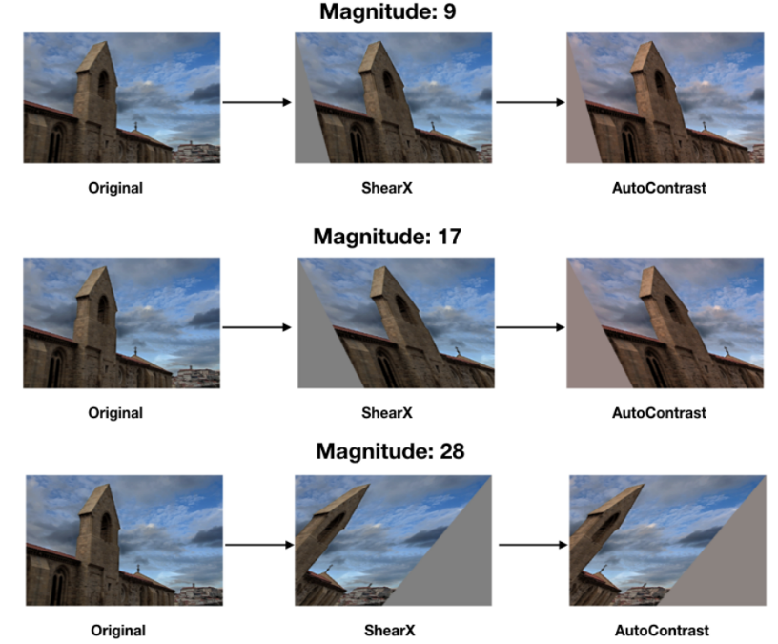
Source: Screen_Shot_2020-06-06_at_1.39.41_PM.png (1188×626) (paperswithcode.com)

Slide 7
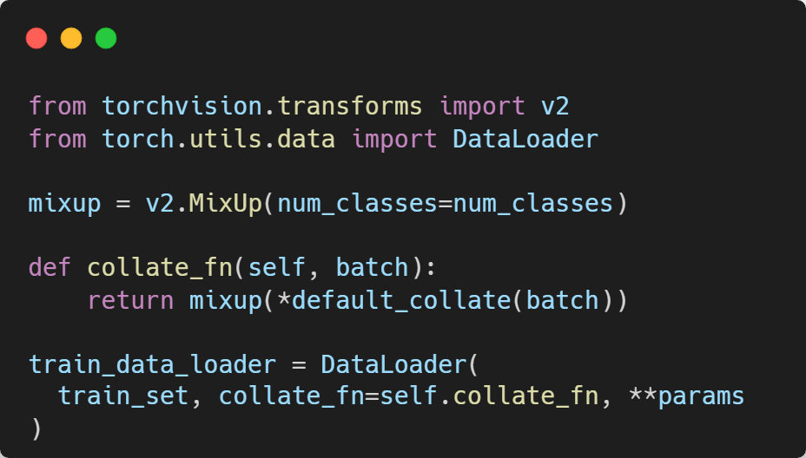

MixUp
Q. Why?
Introducing diversity in both input and labels leads to strong regularization.
$$\hat{x}=λx_{i}+\left(1−λ\right)x_{j}$$
$$\hat{y}=λy_{i}+\left(1−λ\right)y_{j}$$
Zhang, Hongyi, Moustapha Cisse, Yann N. Dauphin, and David Lopez-Paz. "mixup: Beyond empirical risk minimization." arXiv preprint arXiv:1710.09412 (2017).

Slide 8
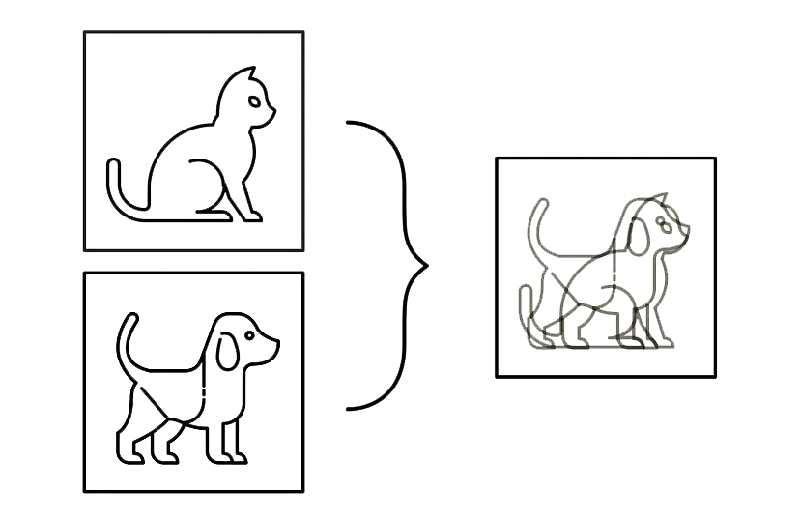
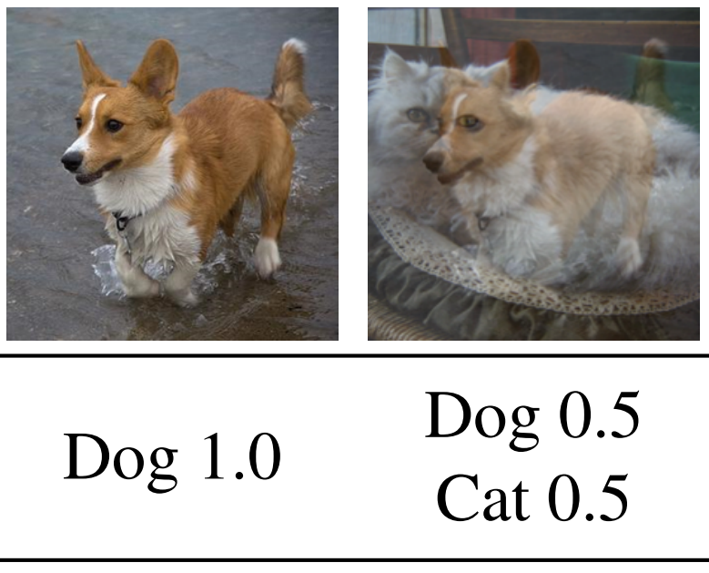
Source: Cutmix: Regularization strategy to train strong classifiers with localizable features.
Source: Cutout, Mixup, and Cutmix: Implementing Modern Image Augmentations in PyTorch | by Leonie Monigatti | Towards Data Science

Slide 9
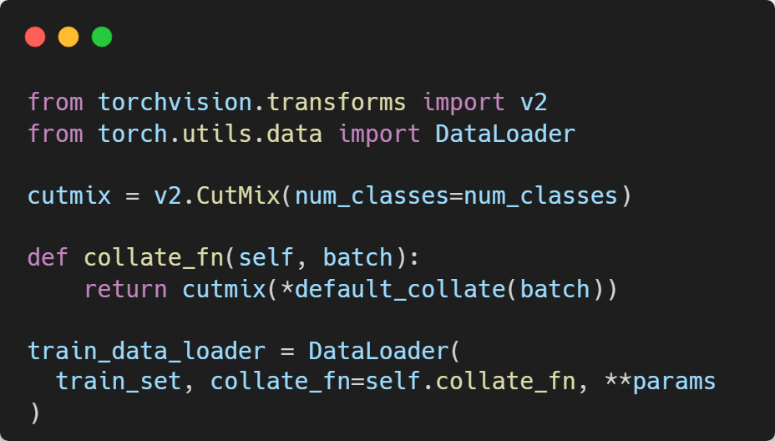
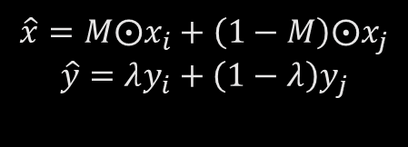
CutMix
Successor to CutOut.
Q. Why?
Introducing diversity in both input and labels leads to strong regularization.
$$\hat{x}=M⨀x_{i}+\left(1−M\right)⨀x_{j}$$
$$\hat{y}=λy_{i}+\left(1−λ\right)y_{j}$$
Yun, Sangdoo, Dongyoon Han, Seong Joon Oh, Sanghyuk Chun, Junsuk Choe, and Youngjoon Yoo. "Cutmix: Regularization strategy to train strong classifiers with localizable features." In Proceedings of the IEEE/CVF international conference on computer vision, pp. 6023-6032. 2019.

Slide 10
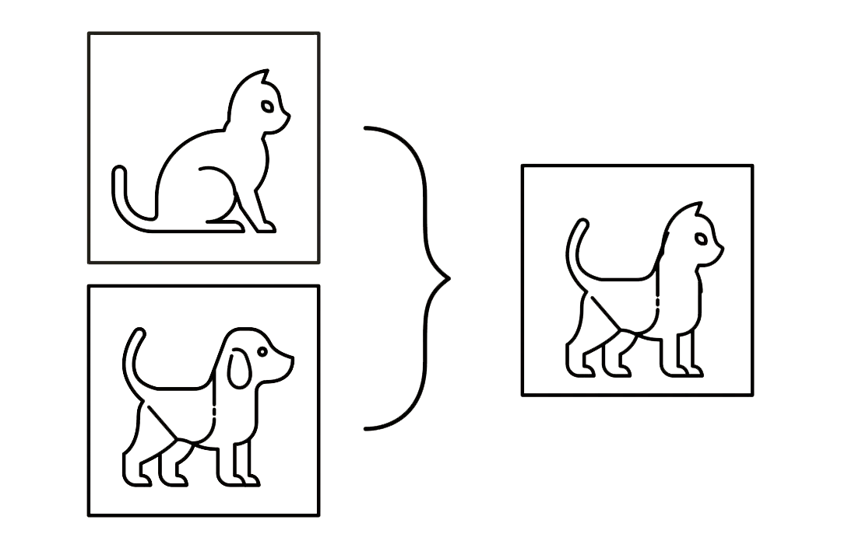
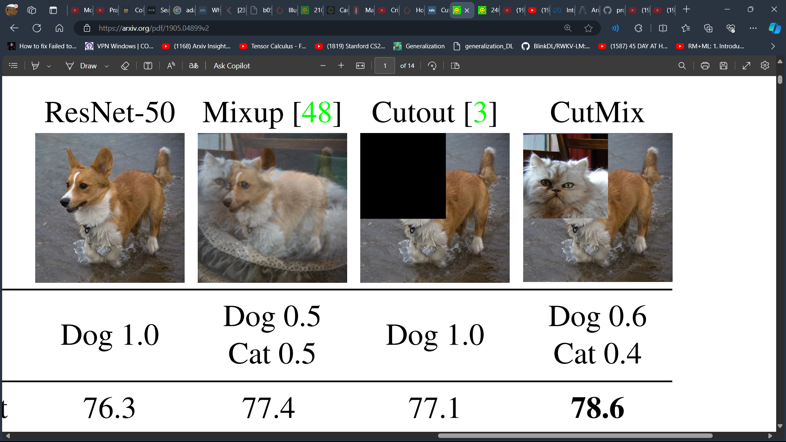
Source: Cutmix: Regularization strategy to train strong classifiers with localizable features.
Source: Cutout, Mixup, and Cutmix: Implementing Modern Image Augmentations in PyTorch | by Leonie Monigatti | Towards Data Science

Slide 11
Model Optimization
Hyper-parameter tuning along with the right tools for optimization is the core for achieving the bulk of the performance in Deep Learning

Slide 12

Learning Rate and Batch Size
$$w_{t+k}=w_{t}−η\frac{1}{n}\sum_{j<k}{\sum_{x∈B_{j}}{∇l(x,w_{t+j})}}$$
$${\hat{w}}_{t+1}=w_{t}−\hat{η}\frac{1}{kn}\sum_{j<k}{\sum_{x∈B_{j}}{∇l(x,w_{t})}}$$
If we assume that $∇l\left(x,w_{t+j}\right)≈∇l(x,w_{t})$, for $j<k$ then ${\hat{w}}_{t+1}≈w_{t+k}$ if $\hat{η}=kη$.
$∇l\left(x,w_{t+j}\right)≈∇l(x,w_{t})$ is a very strong assumption.
But, it works in practice.
Take Home Message: Apply linear scaling rule for learning rate and batch size.
Goyal, Priya, Piotr Dollár, Ross Girshick, Pieter Noordhuis, Lukasz Wesolowski, Aapo Kyrola, Andrew Tulloch, Yangqing Jia, and Kaiming He. "Accurate, large minibatch sgd: Training imagenet in 1 hour." arXiv preprint arXiv:1706.02677 (2017).

Slide 13

Weight Decay: The Correct Way
Q. What is weight decay?
A. $g_{t}=g_{t}+λθ_{t−1}$
Q. How is it different from L2 regularization?
A. For Plain SGD, L2 reg and weight decay are equivalent. This is not the case for the Adam optimizer.
Hence, AdamW was born.
Q. What is the issue with applying weight decay to bias parameters?
A. Check out the graph on the next page.

Slide 15
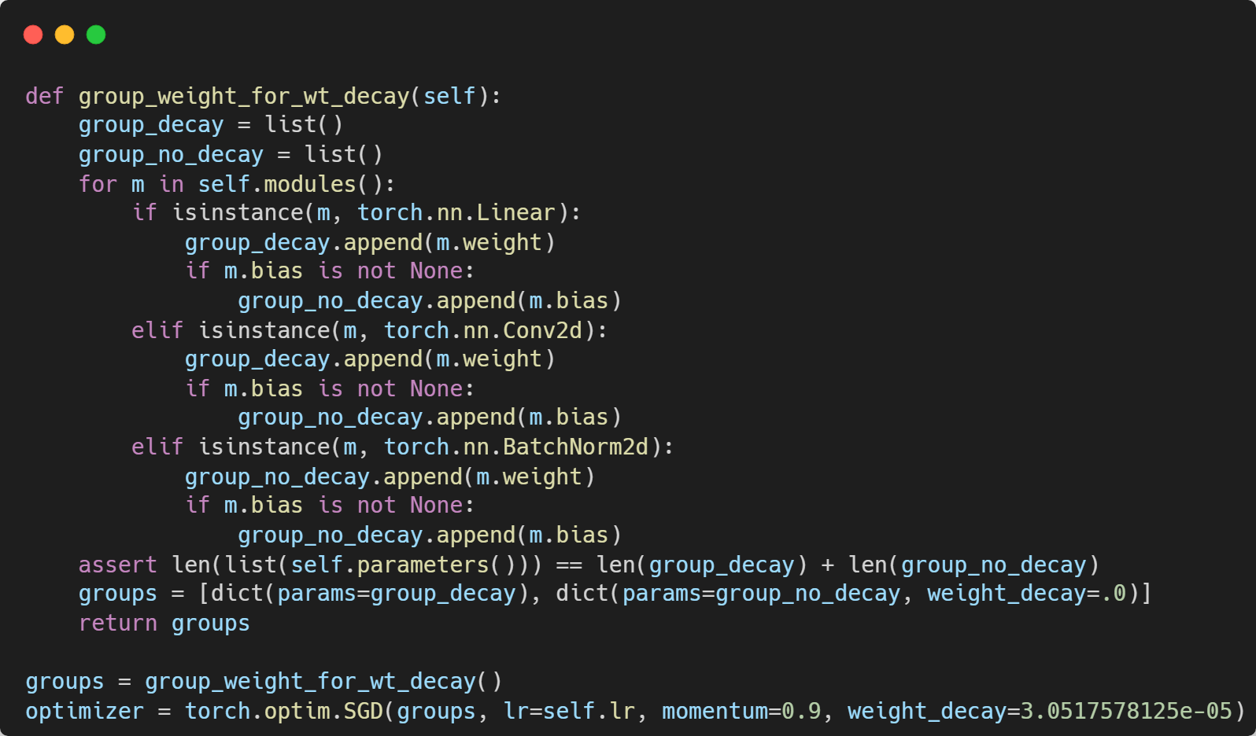

Slide 16

BatchNorm and Learning Rate
If $η$ is the learning rate and $λ_{1}$ is the maximum eigenvalue of the Hessian of the loss function with respect to the parameters of the model, then
$$η<\frac{2}{λ_{1}}$$
As per Santurkar et al. [1], Batch Normalization (BN) reduces $λ_{1}$.
Hence, BN enables large learning rates (which is the main advantage of BN as per Bjorck et. al.[2]).
Take Home Message: When applying BN, make sure to increase the learning rate
[1] Santurkar, Shibani, Dimitris Tsipras, Andrew Ilyas, and Aleksander Madry. "How does batch normalization help optimization?." Advances in neural information processing systems 31 (2018).
[2] Bjorck, Nils, Carla P. Gomes, Bart Selman, and Kilian Q. Weinberger. "Understanding batch normalization." Advances in neural information processing systems 31 (2018).

Slide 17
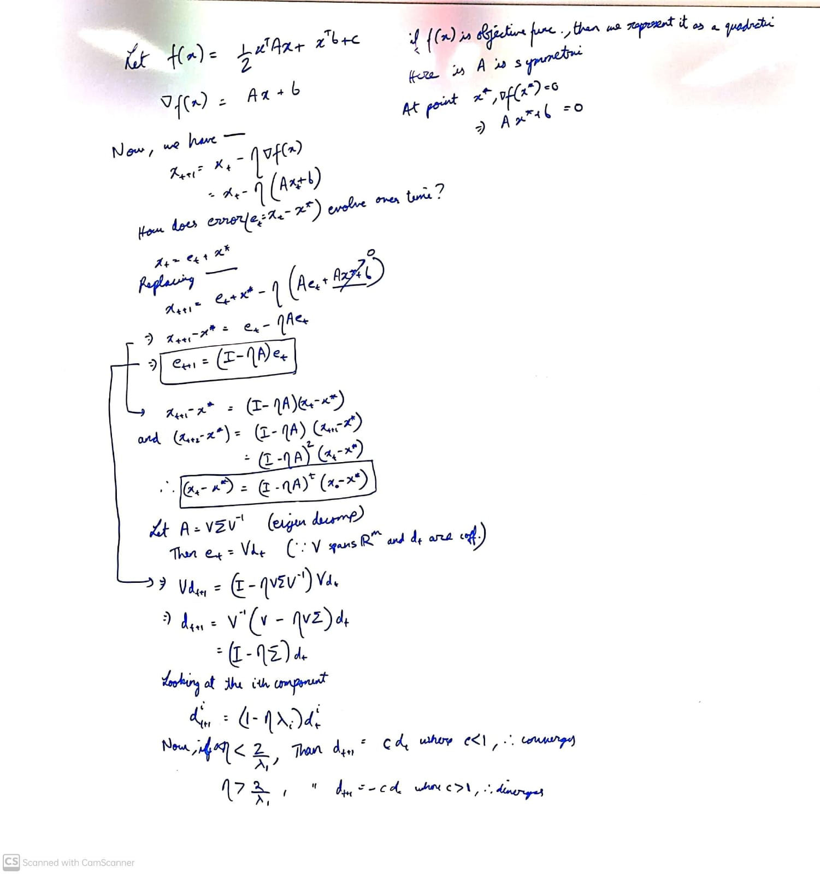

Slide 18

Schedulers make your training go vroom!!
There are many schedulers for different parts of the model, eg. – dropout schedulers, learning rate schedulers, weight decay schedulers, etc.
Q. How should the learning rate evolve over training?
Initially, we want to take large steps towards the local minima during training.
Towards the end of training, we want to take smaller steps and not overshoot.
Q. How to solve this?
Use Learning rate schedulers, specifically, CosineAnnealingLR.
$$η_{t}=η_{min}+\frac{1}{2}\left(η_{max}−η_{min}\right)\left(1+cos\left(\frac{T_{curr}}{T_{max}}π\right)\right)$$

Slide 19
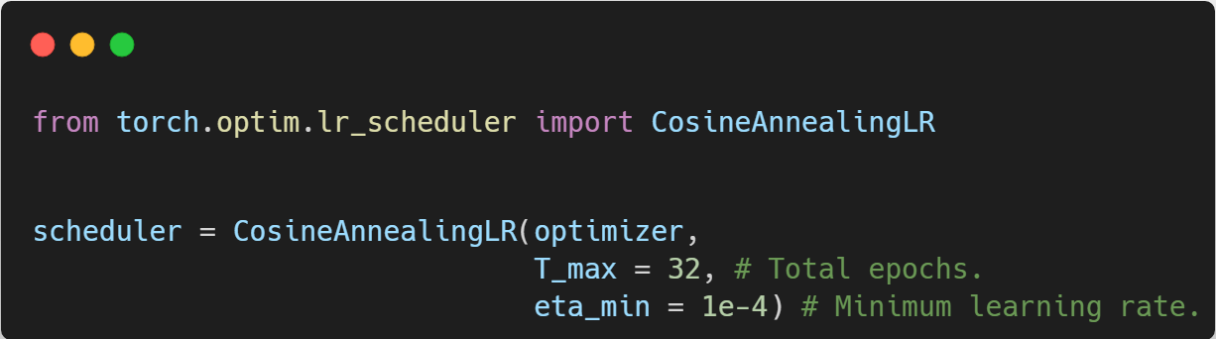

Slide 20
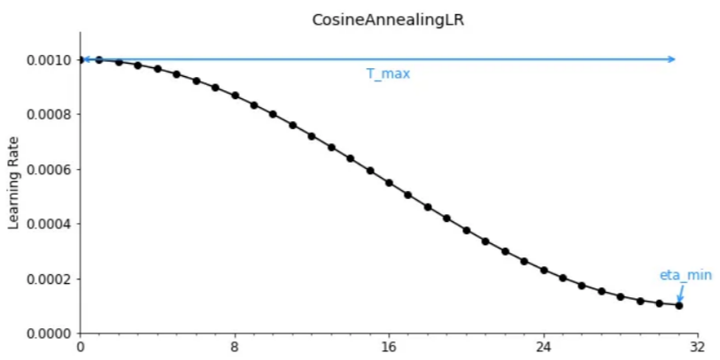
epochs
Source: A Visual Guide to Learning Rate Schedulers in PyTorch | by Leonie Monigatti | Towards Data Science

Slide 21
Which Optimizer to choose?
SGD with momentum for vision with small batch size (<512).
AdamW for large language models.
LAMB for large batch size and any domain.

